Slide 1
Fundamentals of Hardware
Team Members:
Saurabh Mishra
Pratiksha Misal
S. Mangala Harshini
Kirti Devadiga
Tejaswini Sutar
Hima Bindu

Slide 2
INTRODUCTION
INPUT DEVICES
OUTPUT DEVICES
SWITCH MODE POWER SUPPLY
MOTHERBOARD
MEMORY MODULES
PROCESSORS
MEMORY AND STORAGE
CONNECTORS

Slide 3

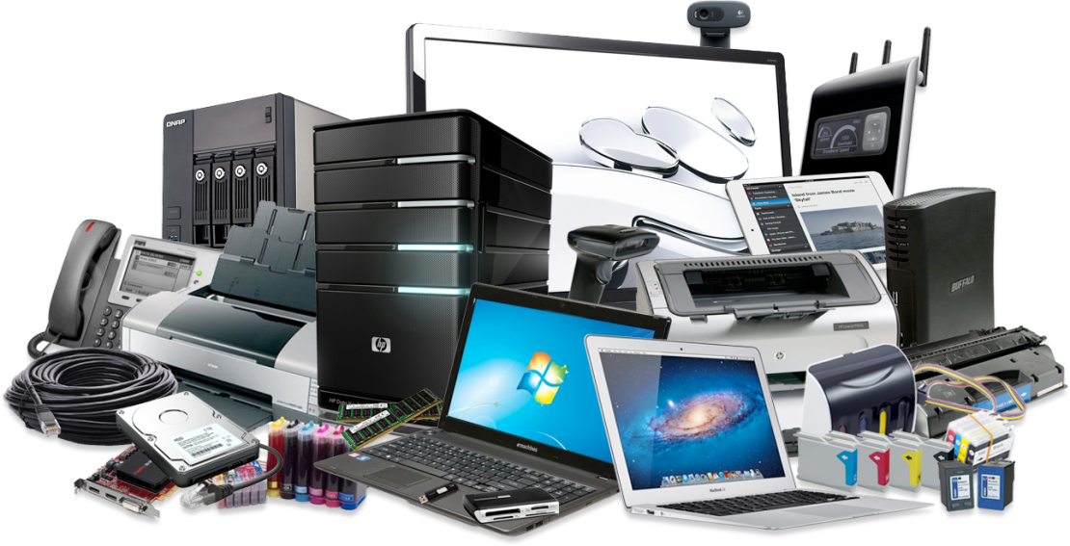
INTRODUCTION
Software:
Software is a collection of instructions that enable the user to interact with a computer, its hardware, or perform tasks.
Hardware:
Hardware is best described as any physical component of a computer system that contains a circuit board, ICs, or other electronics.
tware :
Software is a collection of instructions that enable the user to interact with a computer
For example, without your Internet browser software, you could not surf the Internet
Hardware :
Hardware is best described as any physical component of a computer system that contains a circuit board, ICs, or other electronics

Slide 4
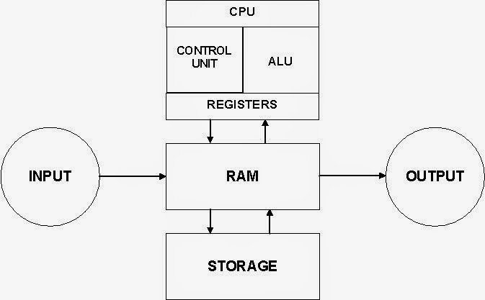
COMPUTER
Computer is an electronic machine that manipulates data according to a set of instruction

Slide 5
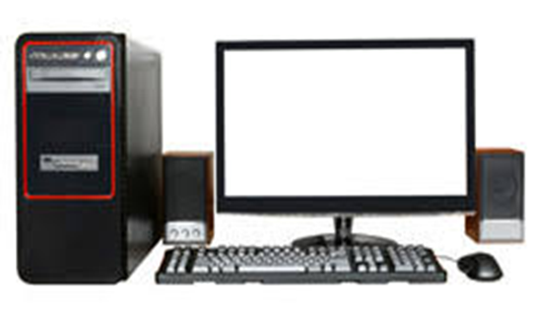
INPUT DEVICES

Slide 6
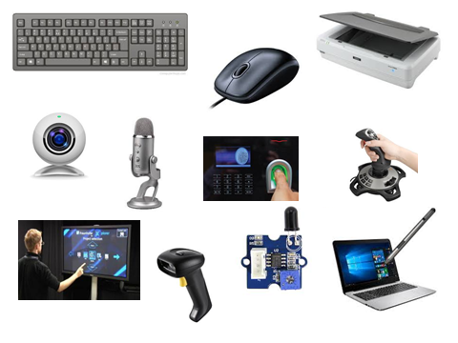

Slide 7
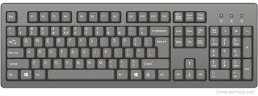
1. Keyboard

Slide 8
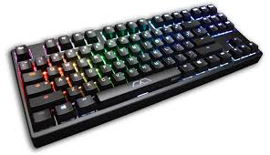
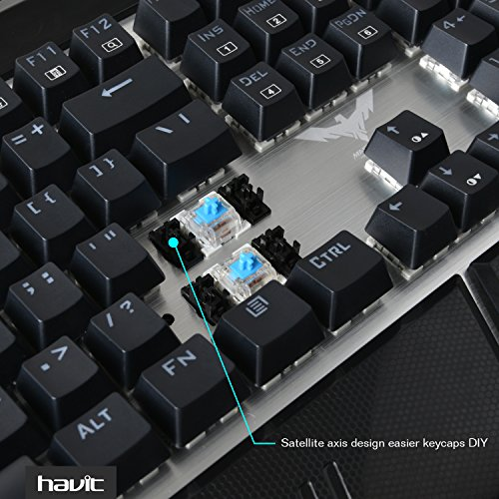
Mechanical Keyboard
A physical keyboard that uses an individual spring and switch for each key. Requires a certain amount of force to be press resulting into sound.

Slide 9
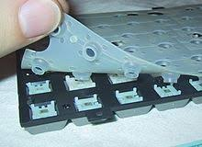

Membrane Keyboard
A membrane keyboard is a computer keyboard whose "keys" are not separate, moving parts, as with the majority of other keyboards, but rather are pressure pads that have only outlines and symbols printed on a flat, flexible surface.

Slide 10
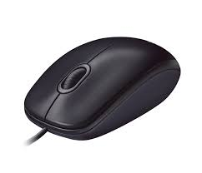
2. Mouse

Slide 11
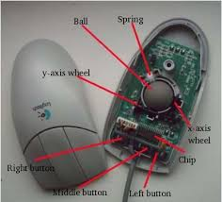
Mechanical mouse
A mechanical mouse is a computer mouse that contains a metal or rubber ball on its under side. When the ball is rolled in any direction, sensors inside the mouse detect this motion and move the on-screen mouse pointer in the same direction.

Slide 12
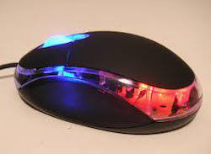
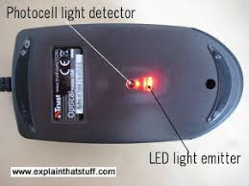
Optical Mouse
This type of mouse utilizes light-emitting diodes (LED) or laser to help track movement. These mice are identified by examining the bottom of the mouse.

Slide 13
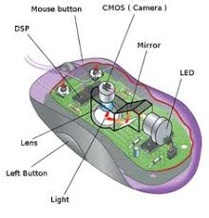
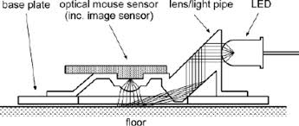

Slide 14
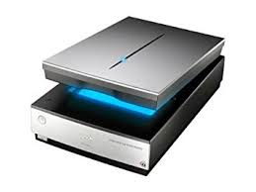
3. Scanner

Slide 15
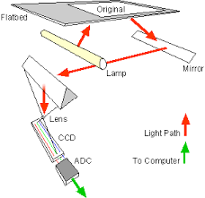
Working of flatbed scanner :

Slide 16
OUTPUT DEVICES

Slide 17
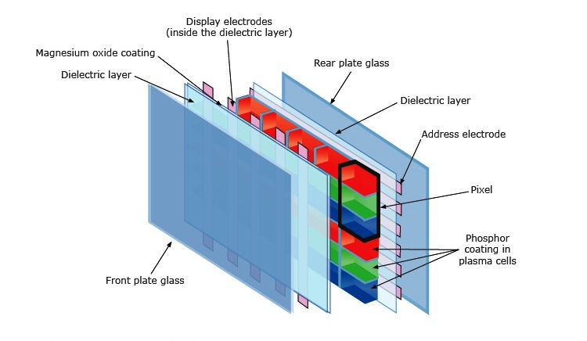
PLASMA
Plasma is referred to be the main element of a fluorescent light. It is actually a gas including ions and electrons. Under normal conditions, the gals has only uncharged particles

Slide 18
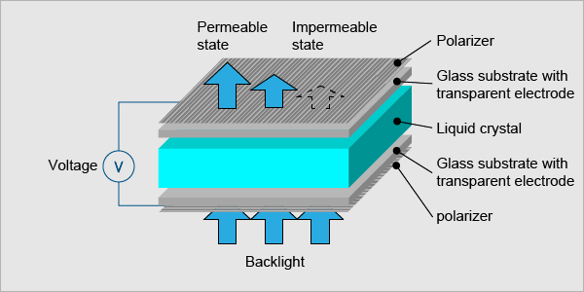
LIQUID CRYSTAL DISPLAY (LCD)

Slide 19
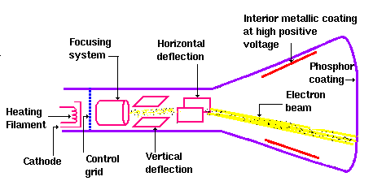
CRT monitor (Cathode Ray Tube):

Slide 20
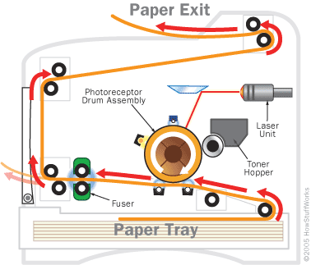
Laser printer:

Slide 21
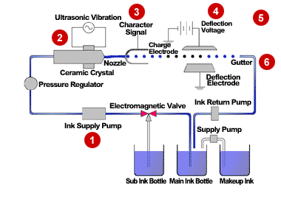
Inkjet Printer

Slide 22
SWITCHED MODE POWER SUPPLY

Slide 23
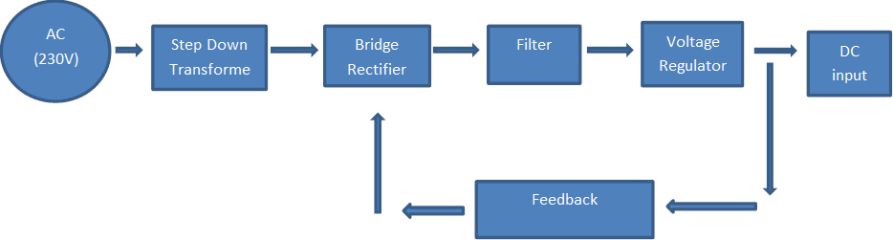
SMPS(Switched Mode Power Supply)
It is a device which converts the ac voltage to desired dc voltage with good voltage regulation and high efficiency.

Slide 24
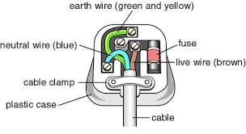
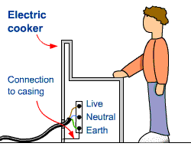
Earthing
Connecting metal parts to the ground using thick wire.
for safety purpose

Slide 25
MOTHERBOARD

Slide 26
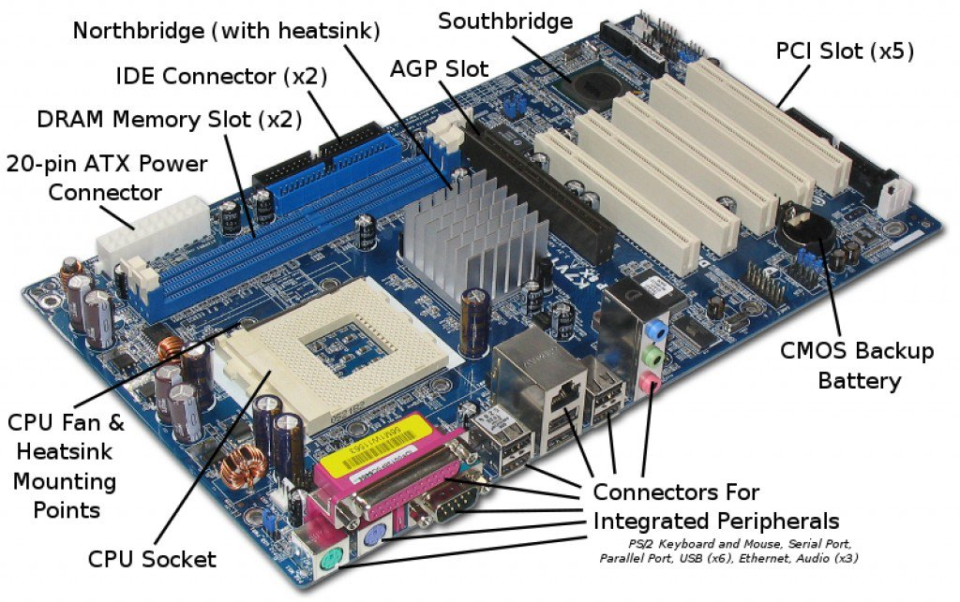
MOTHERBOARD

Slide 27
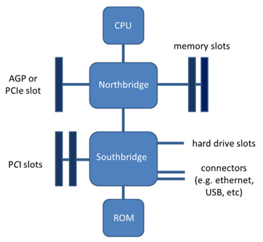
Chipsets on Motherboard
North Bridge:
Memory Controller Hub
Communicates with the computer processor and controls interaction with memory, PCI & AGP
South Bridge:
I/O Controller Hub
manages the basic forms of input/output such as USB, serial , audio, IDE and ISA in a computer

Slide 28
BIOS & CMOS Battery
BIOS (Basic Input/output System): is a program for the initial boot of a computer, equipment adjustment and input/output functions support.
Functions of BIOS :
boot and procedure of self-testing (POST)
system parameters setting
input/output functions support
CMOS battery maintains the time, date, hard disk and other configuration settings in the CMOS memory.

Slide 29
MEMORY MODULES

Slide 30
Memory Modules
A memory module is a circuit board that contains DRAM integrated circuits that are installed into the memory slot on a computer motherboard.
A memory module is another name for a RAM chip. It is often used as a general term used to describe SIMM, DIMM, and SO-DIMM memory.
Type:
SIMM
DIMM
SO DIMM

Slide 31
SIMM
A SIMM, or single in-line memory module, is a type of memory module containing random-access memory used in computers.
It is a chip and connecting pins are present in one side.
It is having two types:
30-pins
72-pins
DIMM
A DIMM or dual in-line memory module comprises a series of dynamic random-access memory integrated circuits
Pins are on both side.
SO DIMM
A SO-DIMM, SODIMM, or small outline dual in-line memory module, is a type of computer memory built using integrated circuits.
Normally found in portable computers.

Slide 32
Difference between SIMM, DIMM and So DIMM
SIMM | DIMM | SO DIMM
Single in-line memory module | Dual in-line memory module | Small outline Dual in-line memory module
SIMM comes in standard form of 30 pins or 72 pins | DIMM comes in standard form of 168,184 or 240 pins | SO DIMM are smaller in size with standard pin out of either 144 or 200 pins
Typically installed in pairs | Installed individually in pairs or in groups | These modules are used to fit in laptop computer
Only supports 32 bit data | Supports 64 bit data transfer | It supports both 32, 64 bit data according to pin number
Used in only PCs | Used in various electronic products along with PCs | Used only in laptops

Slide 33
PROCESSORS

Slide 34
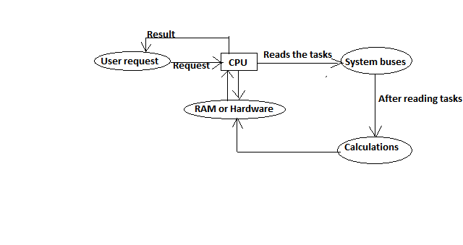
CPU
Central processing unit :
It is a fundamental of components of computers which is designed to processes, calculations and moving data.
It is a complex devices with highly large set of electronic circuitry.
WORKING OF CPU

Slide 35
Types of processors: CISC and RISC
 | RISC | CISC
Acronym | It stands for ‘Reduced Instruction Set Computer’. | It stands for ‘Complex Instruction Set Computer’.
Definition | The RISC processors have a smaller set of instructions with few addressing nodes. | The CISC processors have a larger set of instructions with many addressing nodes.
Memory unit | It has no memory unit and uses a separate hardware to implement instructions. | It has a memory unit to implement complex instructions.
Program | It has a hard-wired unit of programming. | It has a micro-programming unit.
Design | It is a complex complier design. | It is an easy complier design.
Calculations | The calculations are faster and precise. | The calculations are slow and precise.
Time | Execution time is very less. | Execution time is very high.
Pipelining | Pipelining does function correctly. | Pipelining does not function correctly.

Slide 36
Working principles
Multiprogramming:
Only one processor so no simultaneous execution of two different programs.
The operating system executes part of one program, then part of another, and so on.
The operating system selects a job from the job pool and starts executing a job, when that job needs to wait for any i/o operations the CPU is switched to another job
Real time example: Listening to music and in background downloading application from IE.
Multiprocessing:
Multiprocessing refers to executing multiple processes at the same time.
Use of two or more CPU within a single computer system.
Real time example: processing two Microsoft word files at the same time.

Slide 37
Multithreading
It concerns with threads.
The process of executing multiple threads simultaneously is known as multithreading.
Aim to increase utilization of single core by using utilization.
Real time example : Gathering information from different web services running in parallel.
Multitasking:
Multi tasks shares common resources (CPU and Memory).
CPU is executing one task only while other tasks waiting their turn.
Real time example: Talking on the phone while watching television
Time Sharing:
Interactive use of CPU
Allows many users to share components of computer.
Time slots

Slide 38
MEMORY AND STORAGE

Slide 39
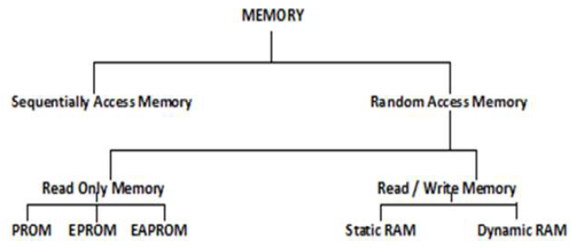

Slide 40
ROM
ROM-Read-only Memory
It is the memory that cannot be changed by a program or user
Types of ROM:
PROM
It is an OTP
These are used in digital electronic devices to store permanently.
EPROM
Erasable PROM
Non Volatile Memory
Reprogramming is possible
EEPROM
Electrically Erasable PROM
The exact location of memory can be reprogrammed.

Slide 41
RAM
RAM is referred to as volatile memory and is lost when the power is turned off.
It is Read and write (R/W) memory of a computer.
Types of RAM:
SRAM
It is fast and expensive.
Uses Flip-flop to store every bit.
It utilizes less power.
It holds data indefinitely as long as the computer is turned on.
DRAM
It is slower and less expensive.
A transistor and a capacitor are paired to create a memory cell.
It holds data dynamically not indefinitely.

Slide 42
Cache Memory
Cache memory, also called CPU memory.
The basic purpose of cache memory is to store program instructions that are frequently re-referenced by software during operation.
Types/Levels :
The level numbers refers to distance from CPU .
Level 1 (L1) Cache
It is also called primary or internal cache. It is built directly into the processor chip.
Level 2 (L2) Cache
It is slower and Its storage capacity is more than L1.
Level 3 (L3) Cache
This cache is separate from processor chip on the motherboard.
It is slower than L1 and L2 cache.

Slide 43
Storage
Types of storage:
Magnetic Storage
Hard Disk
Magnetic Tapes
Optical Storage
CD
DVD

Slide 44
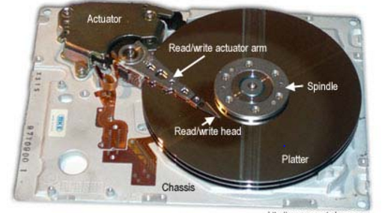
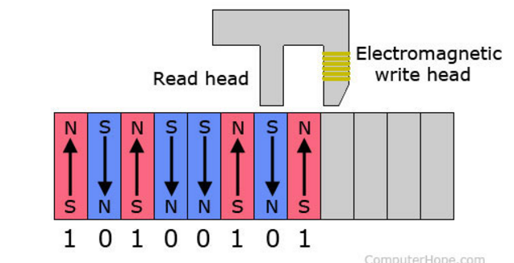
Hard Disk

Slide 45
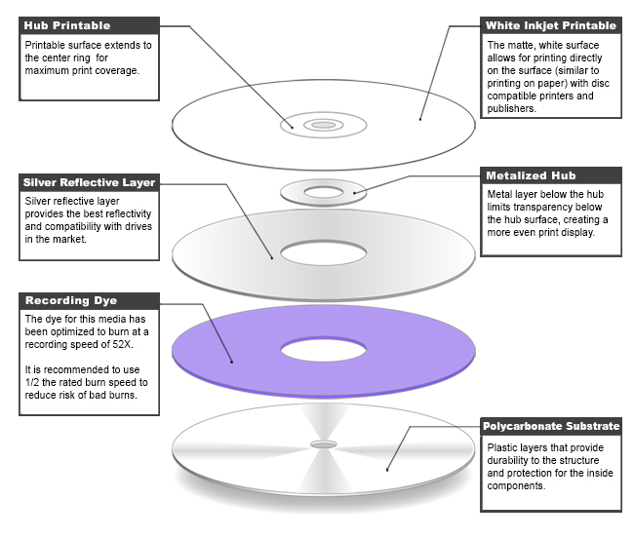
Optical Storage
CD:

Slide 46
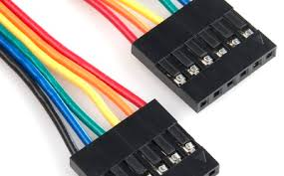
Connectors

Slide 47
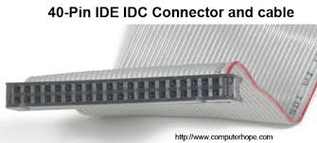
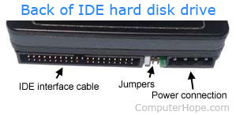
IDE
IDE, an acronym for Integrated Drive Electronics, is a standard type of connection for storage devices in a computer.

Slide 48
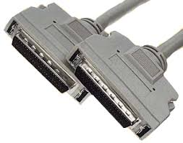
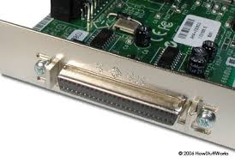
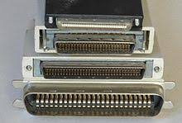
SCSI
Small Computer System Interface is a set of standards for physically connecting and transferring data between computers and peripheral devices.

Slide 49
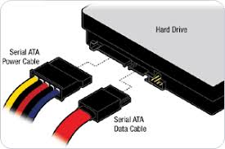
SATA
Serial ATA is a standard for connecting and transferring data from hard disk drives (HDDs) to computer systems.

Slide 50
Thank you

